Slide 1
Internet Advertisement Dataset
Team 7
Chandni Sharma
Hari Panjwani
Sanath Shetty

Slide 2
Problem Space
Dataset represents possible advertisements on pages. Predict ad or non-ad for a particular image based on dimensions of image size, phrases in URL etc.
Our goal is to analyze the data, check for trends to predict whether an image is an ad/non-ad
Notes:
Predict ad/ non ad based on : 1. Geometry
2. phrases in URL
3. anchor text (words near it)
4. alt text

Slide 3
Solution
Outlier Analysis
28% missing data
Other outliers
How to handle NA’s
How to handle the outliers
Using NA approx to handle missing data

Slide 4
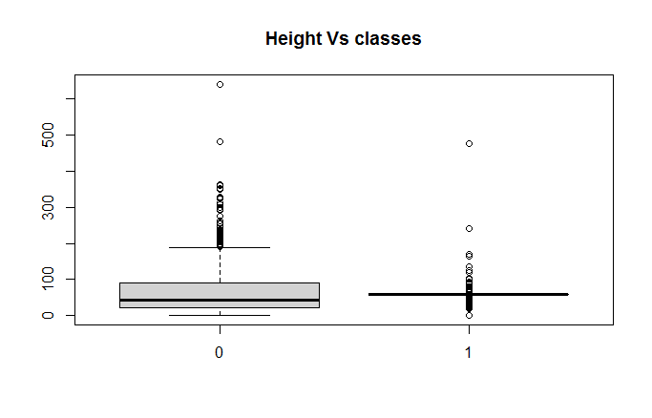
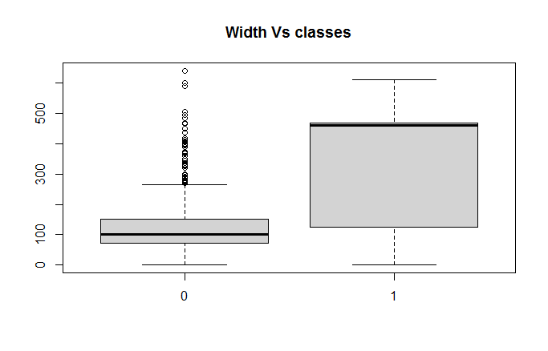
Outlier Identification

Slide 5
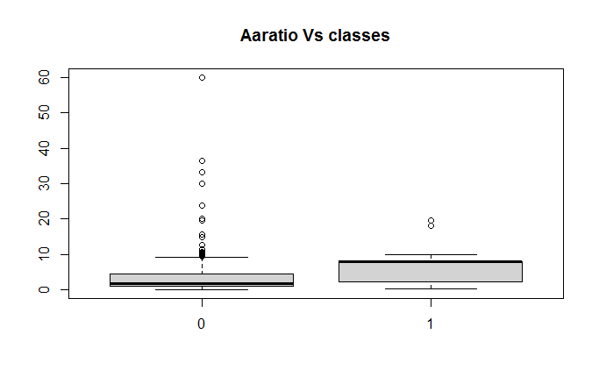
Outlier Identification

Slide 6
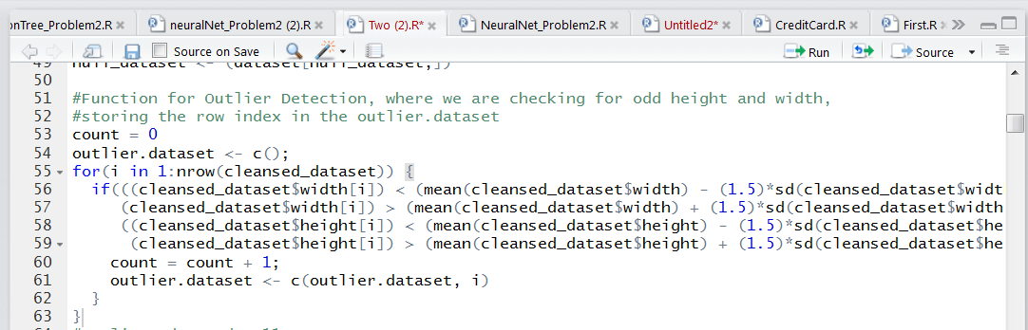
Functions To Handle Outliers

Slide 7
Dimension Reduction
Principal Component Analysis
The main linear technique for dimensionality reduction, principal component analysis, performs a linear mapping of the data to a lower-dimensional space in such a way that the variance of the data in the low-dimensional representation is maximized

Slide 8
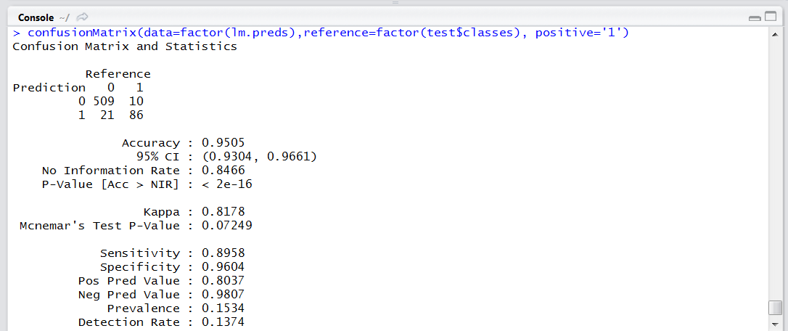
Logistic Regression

Slide 9
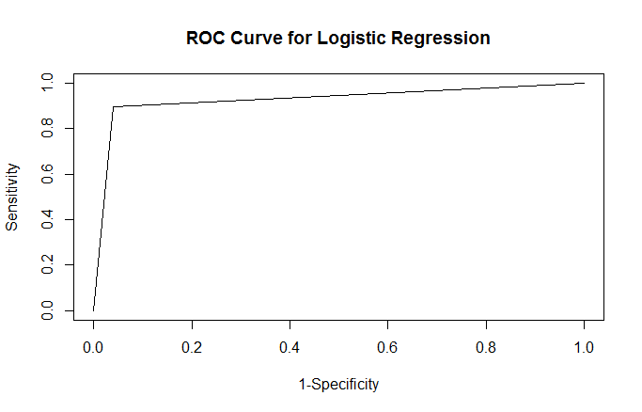
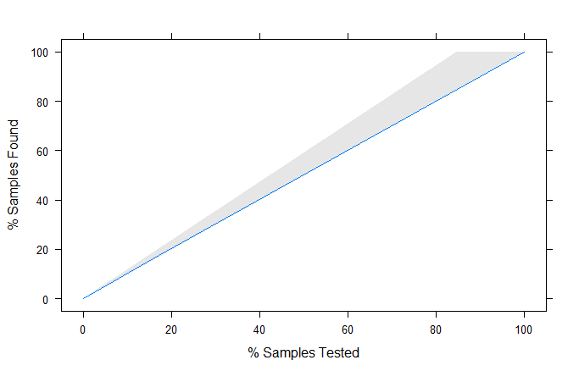
ROC and Lift Curve

Slide 10
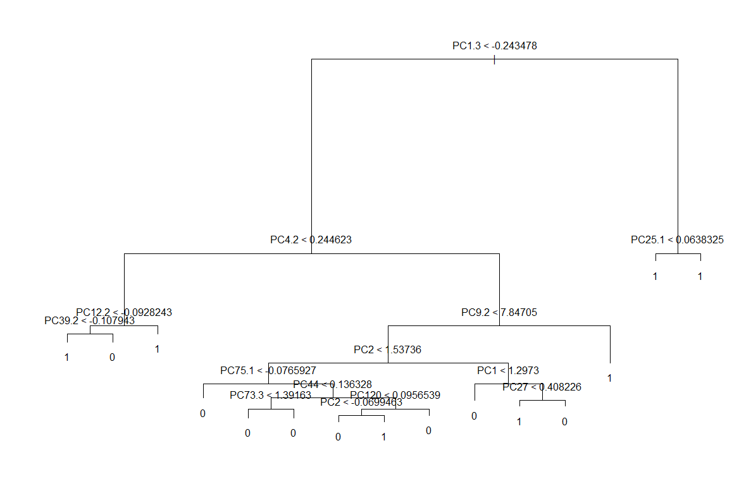
Decision Tree

Slide 11
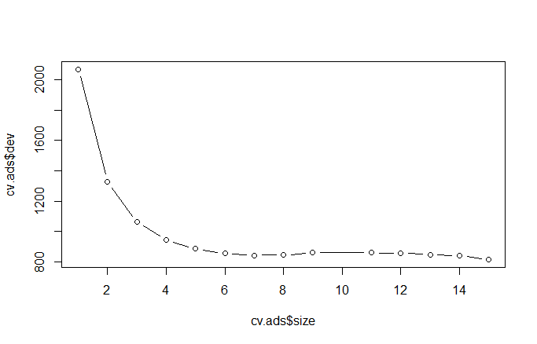
Cross Validation

Slide 12
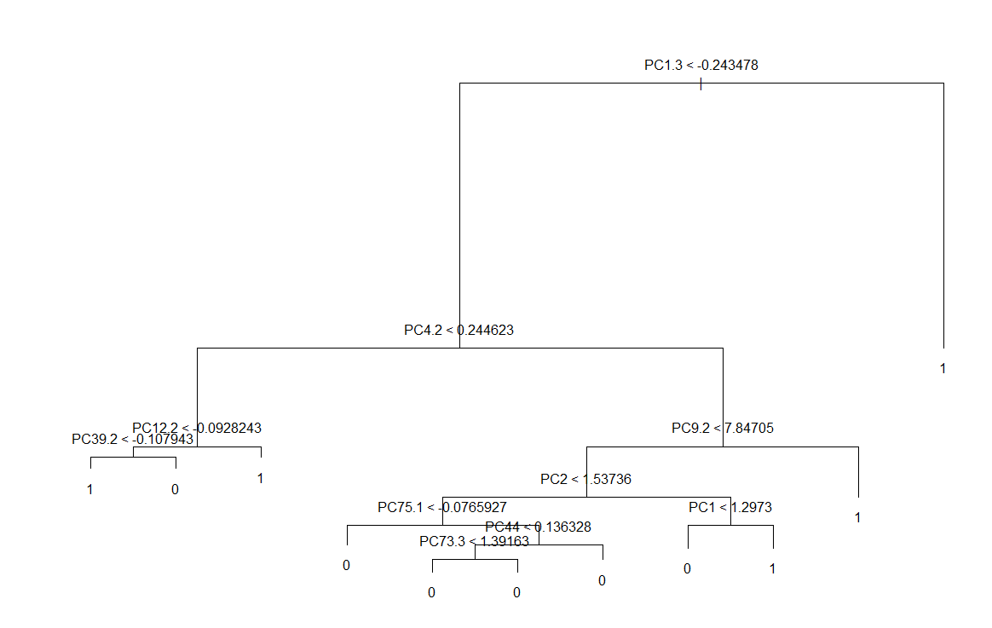
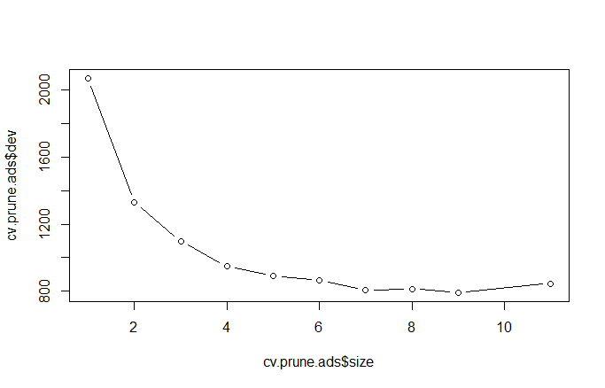
Pruned Decision Tree

Slide 13
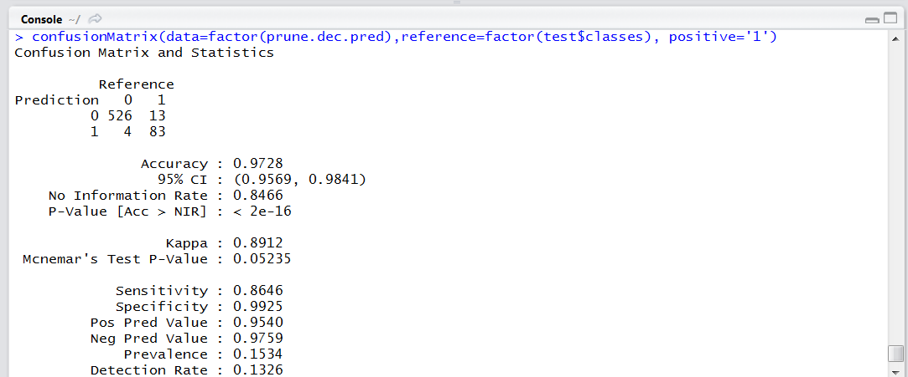
Decision Tree

Slide 14
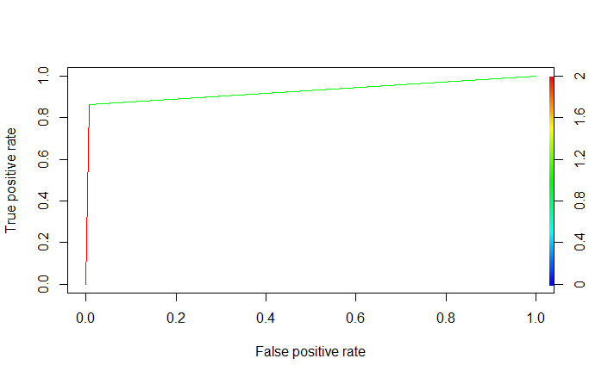
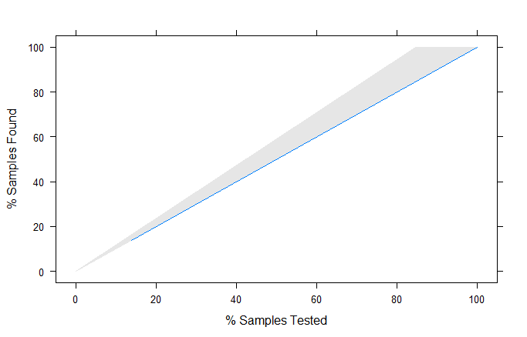
ROC and Lift Curve

Slide 15
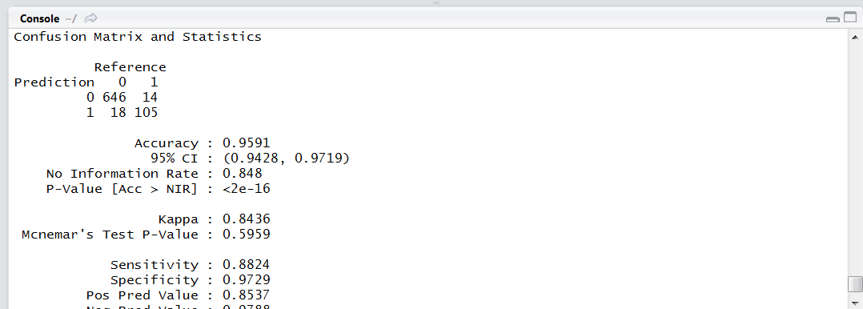
Neural Network

Slide 16
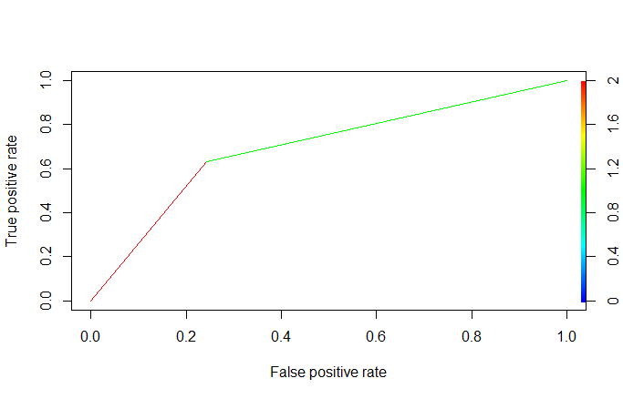
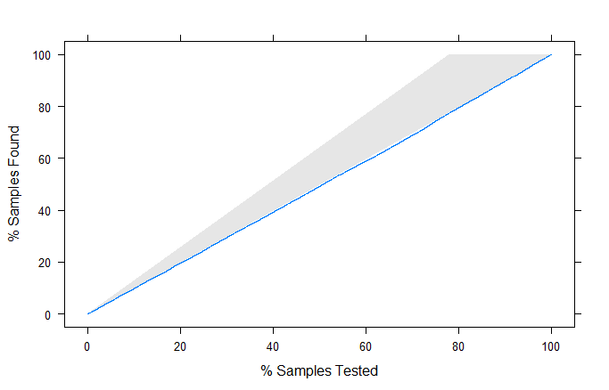
ROC and Lift Curve

Slide 17
Comparison
 | Decision Tree | Neural Network | Logistic Regression
Accuracy | 0.97 | 0.96 | 0.95
Sensitivity | 0.86 | 0.88 | 0.90
Specificity | 0.99 | 0.97 | 0.96

Slide 18
Conclusion
Logistic Tree as our final model because the sensitivity of the model is highest among others i.e., 90%
Our problem is to identified whether the data is ad or not, therefore we need the sensitivity to be high, not just accuracy

Slide 19
Thank You
Any Questions??????????

